Slide 1



Week 2 Summary
ECE 499 Adam Dulay

Slide 2
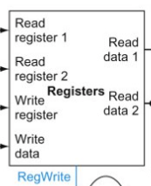
Register File
16x16-bit registers
Made using an array of 16-bit logic vectors
Writes on falling edge as to make decode and writeback occur on the same clock cycle

Slide 3
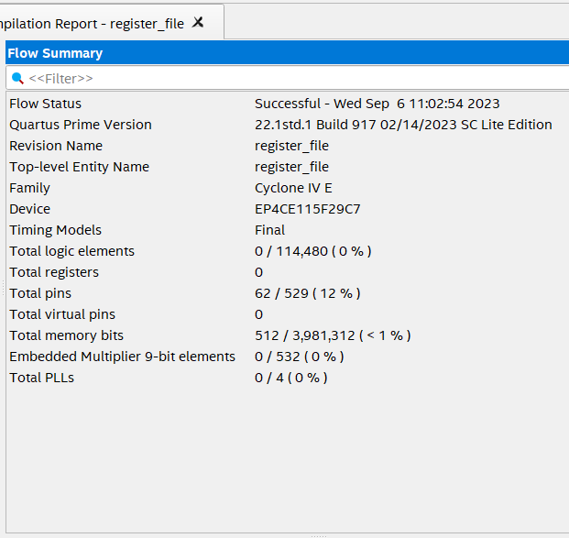
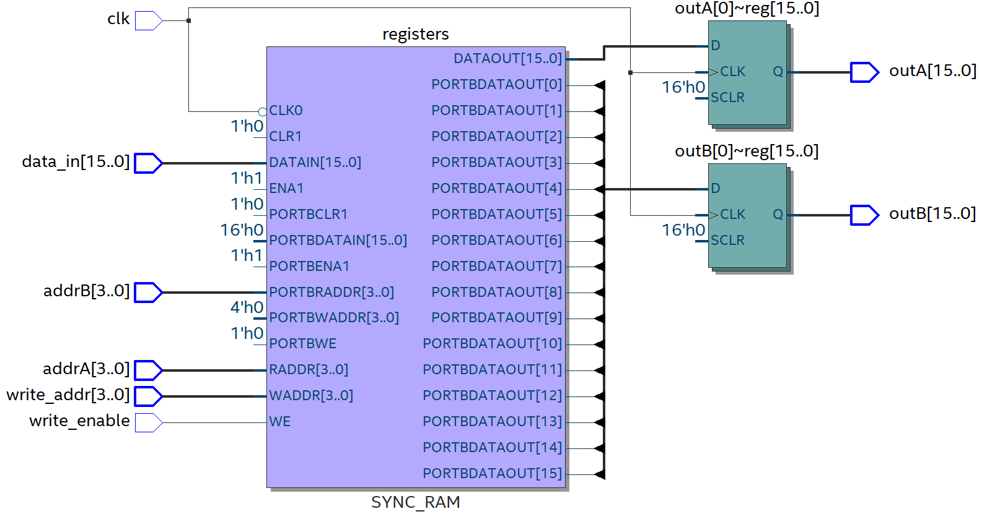
Results

Slide 4
Meeting with Dr. Taha
Told me to research different 16-bit instruction sets to see how they are organized
Has additional resources/tasks for me after I complete this step

Slide 5
Questions?

